Slide 1


Department of Computer Science and Engineering
GE19621 - Professional Readiness for Innovation,Employability and Entrepreneurship
INTELLIGENT THREAT DETECTION SYSTEM
Dr . T.Kumaragurubaran M.Tech.,Ph.D.,AP(SG) Professor
Avinash N
210701036
Aravind D
210701031

Slide 2
Abstract
The "Smart Gas Leakage Monitoring and Control System in Industries Using Gas Sensor (MQ-X), AWS IoT, and ESP Module with anomaly detection using LSTM" is a novel solution aimed at enhancing safety and efficiency in industrial environments where LPG (liquefied petroleum gas) is used. The system is designed to detect gas emissions promptly and take immediate action to prevent potential hazards. The core components of the system include the MQ-X gas sensor for accurate and reliable gas detection, the AWS IoT platform for data management and real- time monitoring, and the ESP module for controlling the gas valve. Upon detecting a gas leak, the system triggers an alert and simultaneously closes the gas regulator valve, preventing further gas emissions. The incident data, including the time of detection, is uploaded to the cloud for audit and analysis purposes.

Slide 3
Existing System
Existing gas leakage monitoring and control systems in industrial settings typically rely on conventional sensors and manual intervention, which can be inefficient and prone to human error. These systems often lack real-time monitoring capabilities and may not provide timely alerts in case of gas leaks. Moreover, the manual nature of these systems can lead to delays in detecting and responding to gas leaks, increasing the risk of accidents.To address these limitations, our project proposes a smart gas leakage monitoring and control system that leverages advanced technologies such as the MQ-X gas sensor, AWS IoT, and ESP module with anomaly detection. By integrating these technologies, our system aims to enhance the efficiency and effectiveness of gas leakage detection and control in industrial environments, ultimately improving safety standards and minimizing the risks associated with gas leaks.

Slide 4
Proposed System
Our proposed system is a smart gas leakage monitoring and control system designed specifically for industrial applications. It integrates the MQ-X gas sensor for accurate gas detection, the AWS IoT platform for real-time data management and monitoring, and the ESP module for controlling the gas valve with detection of anomaly using LSTM model which predicts the risks.The system is designed to detect gas leaks promptly and accurately, triggering an alert and closing the gas regulator valve in real time to prevent further gas emissions. Incident data, including the time of detection, is uploaded to the cloud for analysis and audit purposes. Additionally, the system can be configured to send notifications via WhatsApp for immediate user awareness.By leveraging advanced technologies and real-time monitoring capabilities, our proposed system aims to enhance safety standards in industrial environments, providing a proactive approach to gas leakage detection and control.

Slide 5
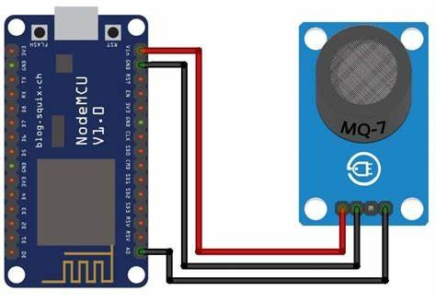
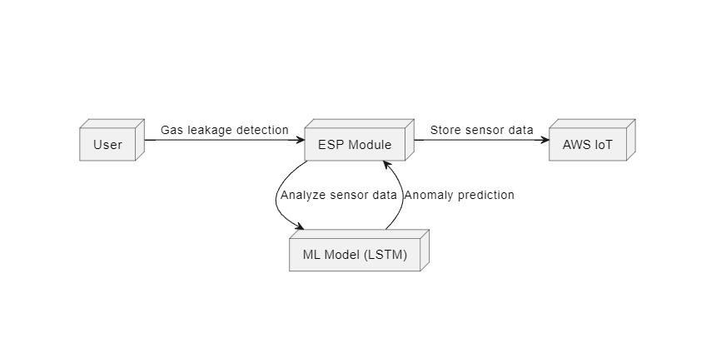
System Architecture

Slide 6
List of Modules
ESP 8266
Bread Board
Sensor Devices
Jumper Wires

Slide 7
Functional Description for each modules
MQ-X Gas Sensor
Gas Detection: The sensor must accurately detect the presence of LPG gas within the specified detection range.Sensitivity Control: Ability to adjust sensitivity levels to cater to different environmental conditions and concentrations of gas.Real-time Monitoring: Continuously monitor the gas levels and provide immediate feedback to the control system.Reliability: Ensure consistent and reliable operation to minimize false alarms and ensure accurate detection of gas leaks.

Slide 8
Functional Description of Module
Gas Valve Control: Control the gas regulator valve to open or close based on signals received from the gas sensor.Response Time: Ensure swift response to gas leak detections by promptly closing the valve to prevent further gas emissions.Reliability: Ensure reliable operation of the module to prevent potential failures that could compromise safety.Compatibility: Interface effectively with both the gas sensor and the AWS IoT platform for seamless communication and integration.Training the machine learning model.

Slide 9
Functional Description of Module
Long Short-Term Memory LSTM
By incorporating an LSTM machine learning model into the system, we enhance its predictive capabilities, allowing for more accurate and proactive gas leak detection while minimizing false alarms. This enables the system to react swiftly and effectively to potential hazards, further enhancing safety in industrial environments where LPG is utilized..

Slide 10
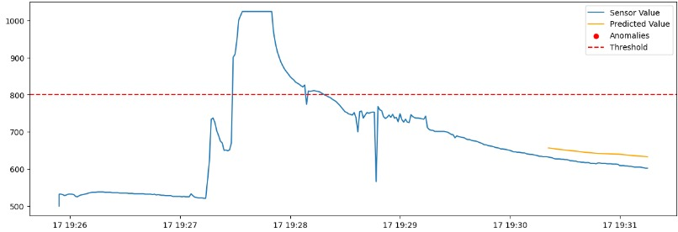
Output

Slide 11
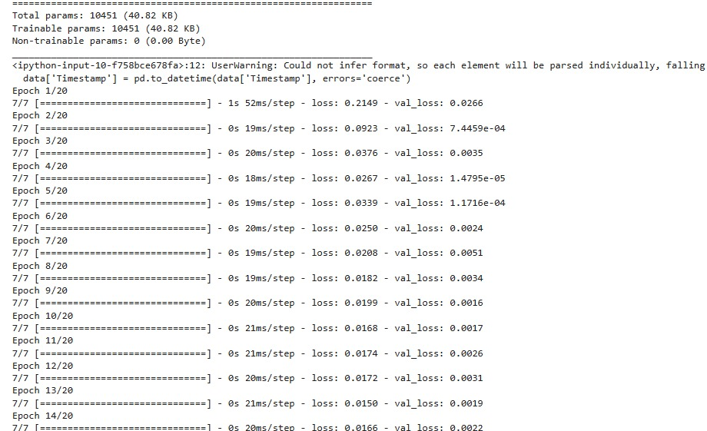
Output

Slide 12
Conclusion
In conclusion, our Smart Gas Leakage Monitoring and Control System in Industries offers a comprehensive and effective solution for enhancing safety and operational efficiency. The system's integration of the MQ-X gas sensor, AWS IoT platform, and ESP module has proven to be highly effective in detecting gas leaks promptly and taking immediate action to prevent accidents. The system's real-time monitoring capabilities, automated valve control, and user-friendly interface make it a valuable asset in industrial environments where gas safety is paramount

Slide 13
References
A.S. Mohamed and N. G. Raja, "Smart Gas Leakage Detection and Prevention System Using IoT and Machine Learning," 2020 International Conference on Emerging Trends in Smart Technologies (ICETST), 2020, pp. 1-5, doi:10.1109/ICETST51473.2020.9216432.
P. Varshini and R. Priyadharshini, "Smart Gas Leakage Detection and Monitoring System Using IoT," 2020 International Conference on Smart Electronics and Communication (ICOSEC), 2020, pp. 632-636, doi:10.1109/ICOSEC49006.2020.9185793
S. S. Bhatia and M. Manikandan, "IoT Based Gas Leakage Monitoring and Detection System Using MQ-2 Sensor," 2020 International Conference on Recent Advances in Electronics and Communication Technology (ICRAECT), 2020, pp. 1-4, doi:10.1109/ICRAECT48207.2020.9150122

Slide 14
Thank You

